Slide 1

EDA ON CHURN PREDICTION

Slide 2
About me:
Relangi Kavya Sri
MBA(Finance)
"I want to learn Data Science because I'm curious about how we can use info to solve problems and make life better. Data Science gives us tools to look at data, find patterns, and make smarter choices, leading to cool new ideas that help us all.“
Linkedin link: https://www.linkedin.com/in/kavyasrirelangi

Slide 3
Agenda:
Business Problem and Use case domain understanding(If Required)
Objective of the Project
Summary of the Data
Exploratory Data Analysis:
Data Cleaning Steps
Data Manipulation Steps
Univariate Analysis Steps
Bivariate Analysis Steps
Key Business Question
Conclusion (Key finding overall)
Q&A Slide
Your Experience/Challenges working on Web Scraping – Data Analysis Project.

Slide 4
BUSINESS PROBLEM:
The primary business problem in churn data is to understand why customers are leaving the service and to develop effective strategies to retain them. By analyzing various factors such as customer demographics, usage patterns, and contract details, telecom companies seek insights to proactively address churn and enhance customer satisfaction, thereby ensuring long-term business sustainability and growth.
OBJECTIVE:
To predict customer churn.
Highlighting the main variables/factors influencing customer churn.
Use various ML algorithms to build prediction models , evaluate the accuracy and performance of these models.
Finding out the best model for our business case & providing executive summary.

Slide 5

SUMMARY OF THE DATA:
Source dataset is in CSV format.
Dataset contains 7043 rows and 14 columns.
Customers who left within the last month – the column is called Churn.
There is no missing values for the provided input dataset.
Churn is the variable which notifies whether a particular customer is churned or not.
Exploratory Data Analysis (EDA) is an approach to analyse datasets & to summarize their main characteristics , often with visual methods.

Slide 6

REQUIRED LIBRARIES & MODULES:
Pandas
Matplotlib
Seaborn
Scikit-learn
Sklearn.modelselection
Sklearn.preprocessing
Sklearn.metrics

Slide 7
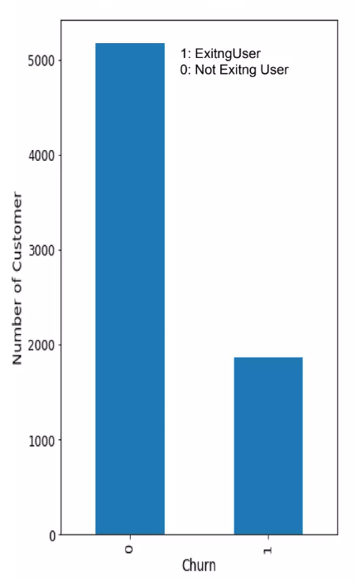
BAR PLOT
Shows that the users from the data are likely to be continuing their subscription plan (>70%).

Slide 8
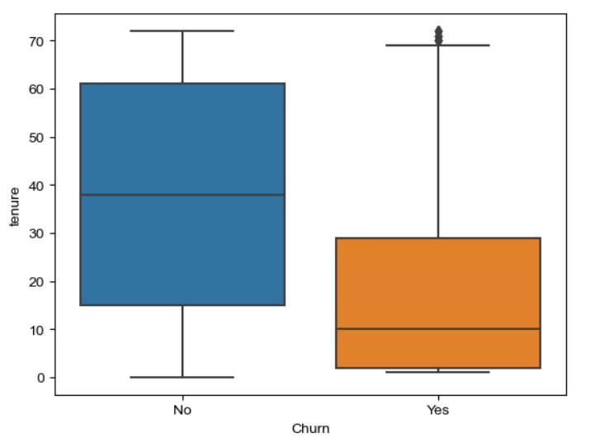
BOX PLOT
We found an outliers in existing customers which is out of whiskers.
Customers who disconnecting their subscription plans are selecting short tenure .So, company need to offer better plans to those customers who choose short tenures.

Slide 9
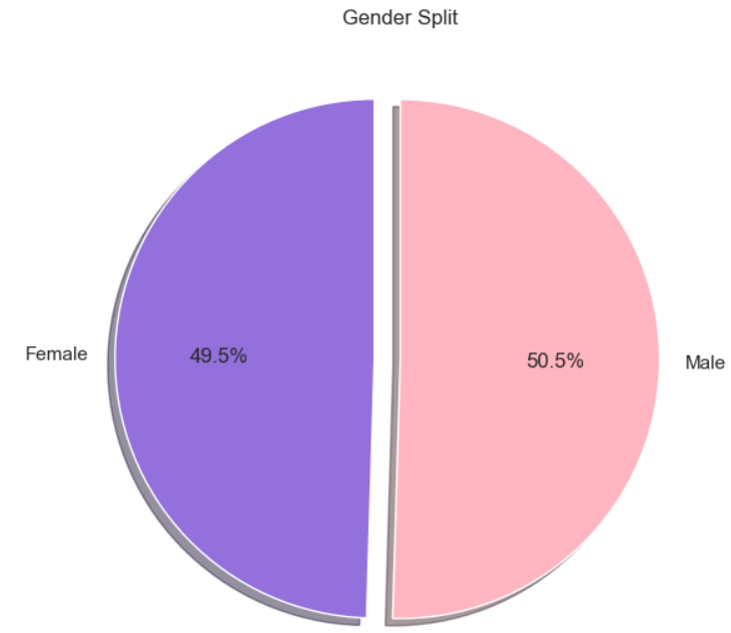
PIE PLOT
Female subscribers are 49.5% of the total.
Male subscribers are 50.5% of the total.

Slide 10
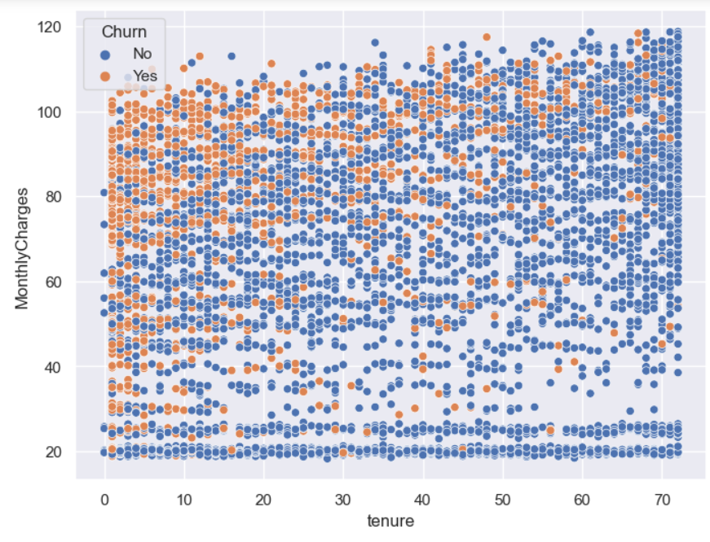
SCATTER PLOT
Customers paying high monthly charges for short tenures are disconnecting.
Customers paying high monthly charges for long tenures are continuing with their subscription plans as it is reasonable cost.

Slide 11
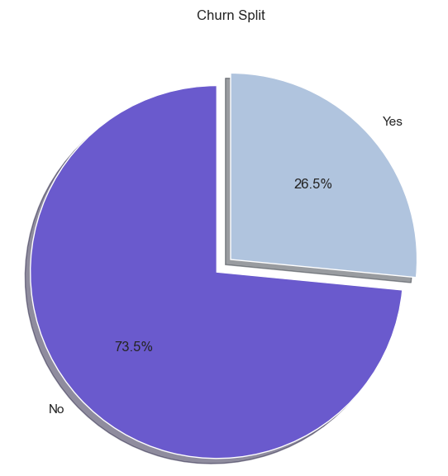
PIE PLOT
According to the collected data 73.5% customers are continuing their subscription and 26.5% customers are disconnected.

Slide 12
CHALLENGES FACED:
Total charges is given as object, so need to convert to float64.
When converted to float it is observed that 11 values are missing so replace them with median.
CONCLUSION:
After completion of end-to-end machine learning project using Churn data. Able to clean the data and visualize the data by visualization and understand the insights of the data. Then able to build a machine learning mode, transformed the categorical to numerical feature. After transforming the data applied 6 different algorithms. Finally Logistic regression obtaining accuracy 0.812606 high among another model when compared.

Slide 13


